Slide 1
OC & EVB Kits Information
FAE Department
May, 2019

Slide 2
1,Ordering Code (OC)
2,EVB Board

Slide 3
LTE Module Ordering Information
E C 20 CE F A S G -512-SGNSX
No.1, S: Standard; U: OpenLinux
No.2, N: no GNSS; G: GPS
No.3, N: no APT; A: APT
No.4, S: Single SIM; D: Dual SIM
No.5, Factory, X: Flex; Q: Qisda；A：All
GW: For China State Grid,
NW: For South China State Grid
Memory size, 512: 512MBytes
G: R2.1; H: Support DFOTA on CEFDKG version
S: 2+2 Flash; K: 2+1 Flash; L: 1+1 Flash
HW version, A: Full function; B: For China State Grid,
D: Simple version, No GNSS and RX Diversity
H: Simple version, No GNSS I: Simple version, No RX
Platform, F: 9x07; HC:1+1 Flash
C: No CDMA and EVDO; CE: with CDMA and EVDO
21: Cat1; 20/25: Cat4; 06: Cat6; 12: Cat12
Package, C: LCC; G: LGA; P: Mini PCIe; M: M.2
M: GSM; U: 3G; E: LTE; B: NB-IoT and eMTC; S: Smart; L: GPS; F: WiFi; A: Automotive

Slide 4
LTE Module (ASR Platform) Ordering Information
E C 2 0 0 T CN D A - N06-SNNSA
No.1-2, MN: Mini PCIe; SN: Standard, No GNSS
No.3, N: no APT, A: APT
No.4, For Standard Module: SIM Card,S: Single SIM, D: Dual SIM; For Mini PCIe Module: D:Mini PCIe-D
No.5, Factory, A: All
Flash size: N06: 16MB Nor Flash; D09: 128MB Nand Flash
Serial Number for HW version/Function change
B：Only for POC application
D: No RX Diversity; B: China State Grid, No RX Diversity;
A: Full Function, support RX Diversity;
M: China Mobile; H: Simple version ,Support RX Diversity
CN: China, No CDMA/TD-SCDMA
Platform code, T is ASR1802S
Default is 0
Project name
Package Size is same with EC20
Package, C: LCC
E: LTE

Slide 5
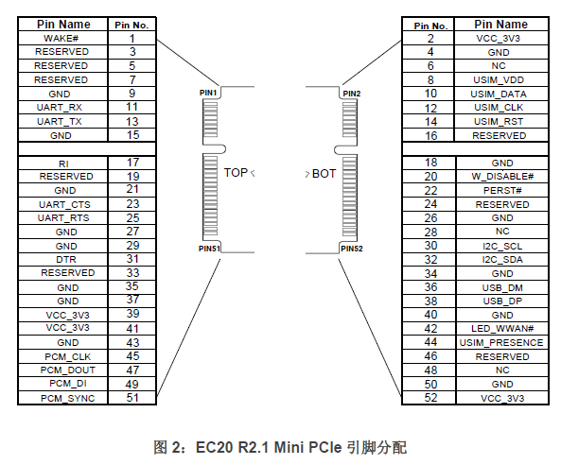
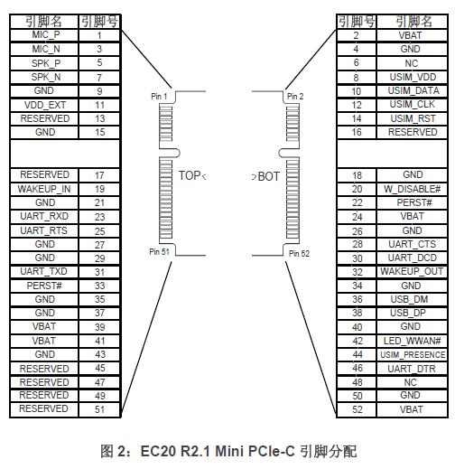
LTE Mini PCIe Module Pin Out
Mini PCIe: Support digital voice Pin out follow Huawei’s module.
Mini PCIe –C: Support Analog voice, Pin out follow Longsung’s module.
Mini PCIe-CB: Not support voice, Pin out follow Longsung’s module.

Slide 6
Automotive Module Ordering Information
A G 35 CE N F A -512-SGASX
No.1, S: Standard; U: OpenLinux
No.2, N: no GNSS; G: GPS
No.3, N: no APT; A: APT
No.4, S: Single SIM; D: Dual SIM
No.5, Factory; X: Flex
Memory size, 512: 512MBytes
Hardware version:
Platform; F:MDM9x07; V: MDM9628
CEN is Cost Down version compared with CE
Region; CE: China; E:EMEA; J: Japan; NA: USA
35: Cat4; 36: Cat6
Package, G: LGA;
A: Automotive

Slide 7
GSM Module Ordering Information
M 26 F A -03 -STD
STD: Standard
CPU: OpenCPU
TTS: TextToSpeech
BT: Support Bluetooth
Memory size, 03 is 3MBytes; 04 is 4MBytes
Hardware Version: A or B
Chipset Platform; F: MT6261x; M: RDA8955
Module Name
M: GSM

Slide 8
GSM Combo Module Ordering Information
MC 20 E C A -04 -STD
STD: Standard
CPU: OpenCPU
TTS: TextToSpeech
BT: Support Bluetooth
BLE: Support BT4.0
Memory size, 04 is 4MBytes
Hardware Version; A or B
Chipset Platform; C:MT2503D; M: RDA8955
Support BLE
Module Name
MC: GSM+GNSS combo

Slide 9
NB (Hisilicon V120) Module Ordering Information
B C 95 B5 HB - 02 - STD
STD: Standard
Memory size, 02 is 2MBytes
Hardware Version
Band; B5 for China Telecom; B8 for CMCC and CUCC
95: Hisilicon Platform
Package; C: LCC
B: NB IoT

Slide 10
NB (Hisilicon V150) Module Ordering Information
B C 35 G JB - 02 - STD
STD: Standard
CPU: OpenCPU
Memory size, 02 is 2MBytes
Hardware Version
G: Full band
35: China Market; 95: Oversea Market; 28: Small Size
Package; C: LCC
B: NB IoT

Slide 11
NB (MTK Platform) Module Ordering Information
B C 26 N B -04 -STD
STD: Standard
CPU: OpenCPU
Memory size, 04 is 4MBytes
Hardware Version
Chipset Platform; N: MT2625DA; S: MT2625SCA; T: MT2621
26: Single NB; 20: NB(B5/B8)+GNSS; 37: NB(B8)+GSM
Package; C: LCC
B: NB IoT

Slide 12
Smart Module Ordering Information
S C 20 CE PA - 8GB - UGASG
No.1, S: Standard; U: OpenLinux
No.2, N: no GNSS; G: GPS
No.3, N: no APT; A: APT
No.4, S: Single SIM; D: Dual SIM
No.5, G: Underfilm
STD: Standard
Memory size, 8GB: 8GB NAND+1GB RAM;
16GB: 16GB NAND+2GB RAM
Hardware Version
Region; CE: China; A: USA; E:EMEA;
J: Japan; AU:Australia
20: MSM8909; 20W: MSM8909 without No Modem Version; 60: SDM450; 60P: MSM8953; 66: SDM660
Package; C: LCC
S: Smart Module

Slide 13
Smart Module Underfilm Ordering Information
 | 原始 OC | Underfilm 点胶 OC
1 | SC20CEA-8GB-STD | SC20CEPA-8GB-UGASG
2 | SC20CEA-8GB-STDDS | SC20CEPA-8GB-UGADG
3 | SC20CEPB-8GB-UGAS | SC20CEPB-8GB-UGASG
4 | SC20CEPB-8GB-UGAD | SC20CEPB-8GB-UGADG
5 | SC20CEPE-8GB-UGNS | SC20CEPE-8GB-UGNSG
6 | SC20CEPE-8GB-UGND | SC20CEPE-8GB-UGNDG
7 | SC20WSA-8GB-STD | SC20WSA-8GB-UNNG

Slide 14
GPS Module Ordering Information
L 7 0 RE L- M37
Chipset Platform
M33: MT3333
M37: MT3337
M39: MT3339
S44: SiRF StarIV
Embedded LNA
RE: Enhanced ROM Version
B: Support GPS+Beidou
0: No GLONASS
6: Support GPS+GLONASS
7: External antenna
8: Embedded antenna
9: Chip antenna
L: GPS

Slide 15

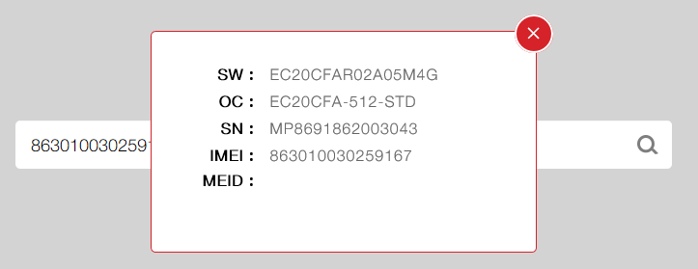
Product Inquiry on Web

Slide 16
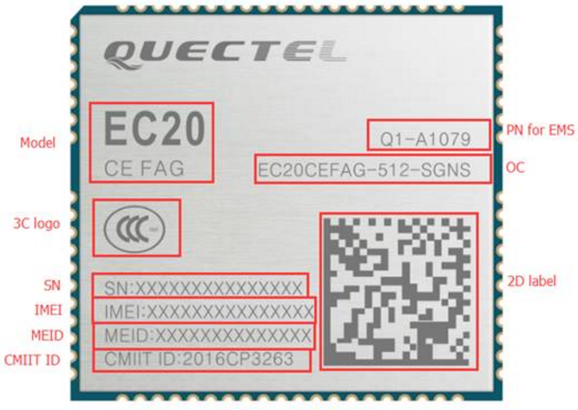
Top Mark of LTE Module

Slide 17
1,Ordering Code (OC)
2,EVB Kits
Notes:
大标题: 黑体 32号字体 色号： R210 G0 B48
大标题: 中文黑体 32号字体 色号： R38 G38 B38

Slide 18
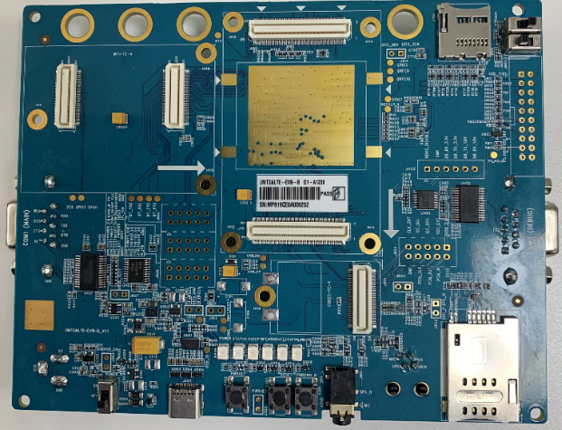
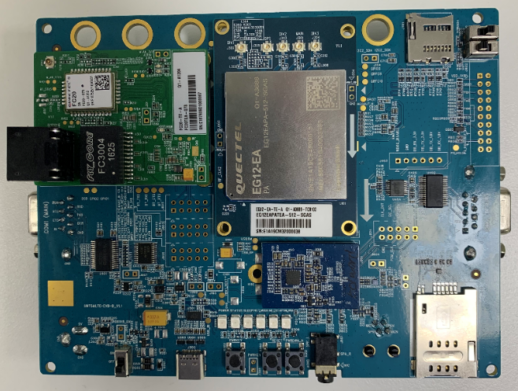
UMTS&LTE EVB -B Kit (with Type C )
FC20 TE-A
LTE Module TE-A
Codec
Board
UMTS&LTE EVB Kit -B
UMTS&LTE EVB-B Kit with TE-A Boards

Slide 19
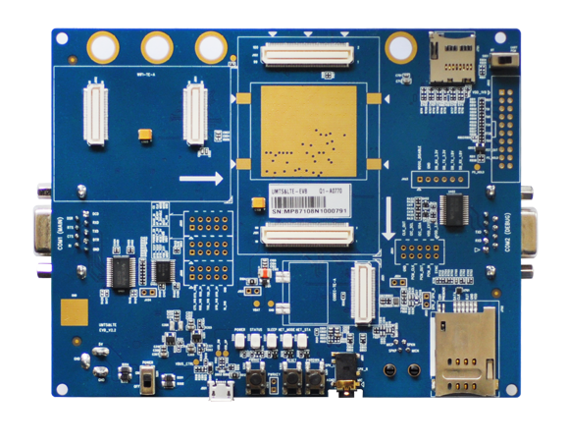
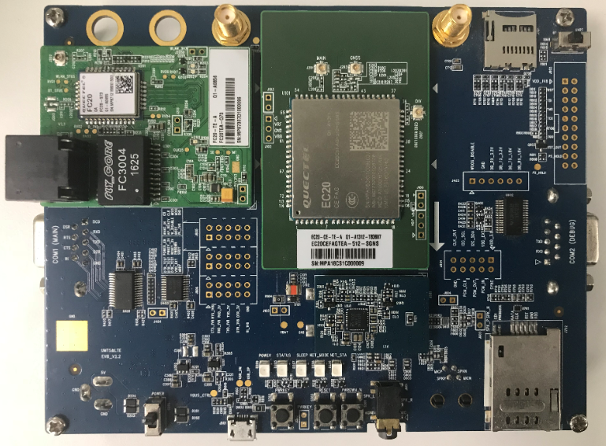
UMTS&LTE EVB Kit (with Micro USB )
FC20 TE-A
LTE Module TE-A
Codec
Board
UMTS&LTE EVB Kit
UMTS&LTE Kit with TE-A Boards

Slide 20
Ordering Code List
Model | Ordering Code
UMTS&LTE EVB Kit | UMTS&LTEEVB-KIT | 3G&4G EVB
FC20-TE-A | FC20TEA-Q73 | WIFI and Ethernet
EC20-CE-TE-A | EC20CEFAGTEA-512-STD | LTE Cat4
EC25 –E-TE-A | EC25EFATEA-512-STD | LTE Cat4
UC20-G-TE-A | UC20GDTEA-128-STD | WCDMA
BG96-TE-A | BG96MATEA-128-SGN | eMTC/NB IoT/GPRS
BG96-NA-TE-A | BG96NAMATEA-128-SGN | eMTC/NB IoT/GPRS
BG36-TE-A | BG36MATEA-128-SGN | eMTC/NB IoT/GPRS

Slide 21
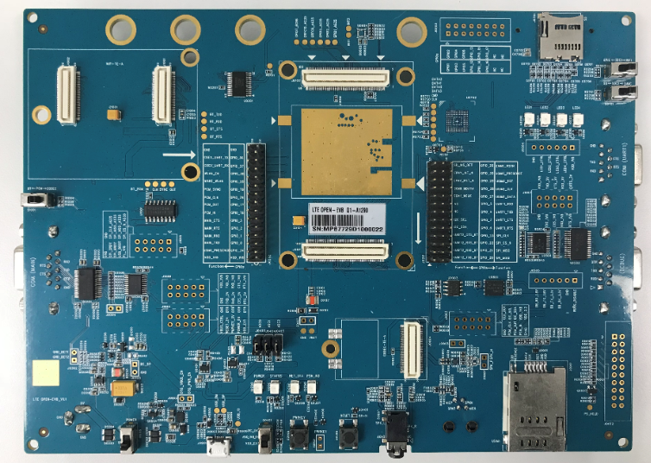
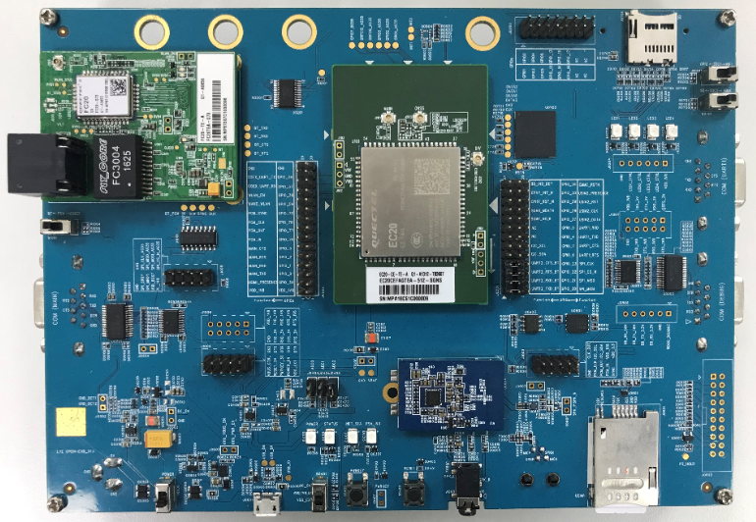
LTE OPEN EVB Kit
FC20 TE-A
LTE Module TE-A
Codec
Board
LTE OPEN EVB Kit
LTE OPEN EVB Kit with TE-A Boards

Slide 22
Ordering Code List
Model | Ordering Code
LTE OPEN EVB Kit | LTEOPENEVB-KIT | For QuecOpenTM Solution
FC20-TE-A | FC20TEA-Q73 | WIFI and Ethernet

Slide 23
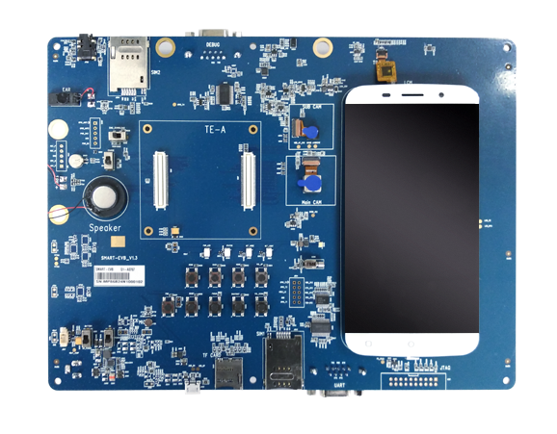
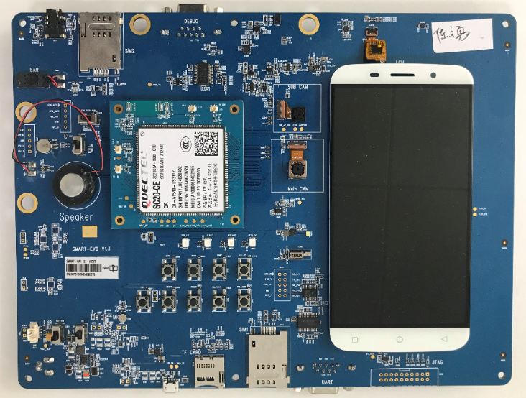
Smart EVB Kit –SC20
SC20 Module TE-A
SC20 EVB Kit
EVB Kit with TE-A Board

Slide 24
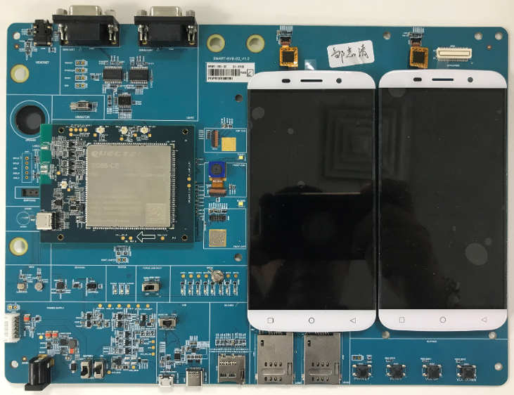
Smart EVB Kit - SC60
SC60 Module TE-A
SC60 EVB Kit with SC60 TE-A Board

Slide 25
Ordering Code List
Model | Ordering Code
SC20 EVB Kit | SMARTEVB-KIT
SC60-EVB Kit | SMARTEVBDL-KIT | Support dual LCM
SC20- E-TE-A | SC20ESATEA-8GB-STD
SC60-CE-TE-A | SC60CEYATEA-16GB-UGAD

Slide 26
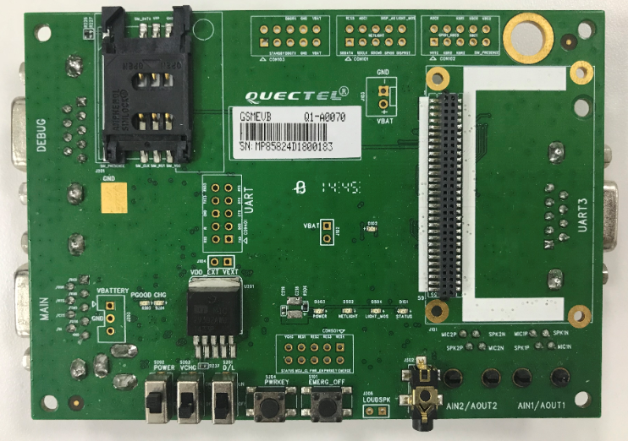
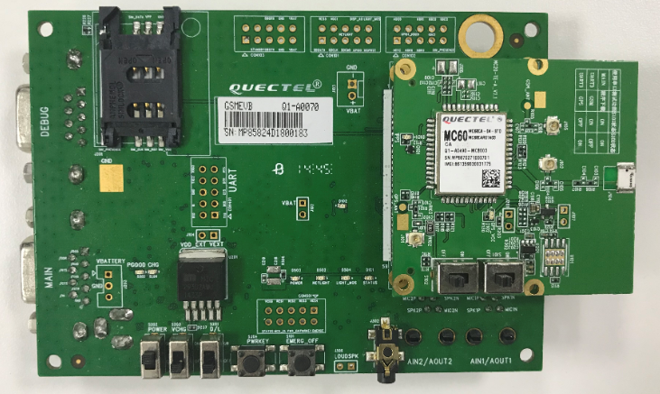
GSM EVB Kit
MC60 Module TE-A
GSM EVB Kit
GSM EVB Kit with TE-A Board

Slide 27
Ordering Code List
Model | Ordering Code
GSM EVB Kit | GSMEVB-KIT | GSM and BC95
M26-TE-A | M26FBTEA-030BT | Support BT
MC20-TE-A | MC20CATEA-04-STD
MC20E-TE-A | MC20ECATEA-04-BLE | Support BT4.0

Slide 28
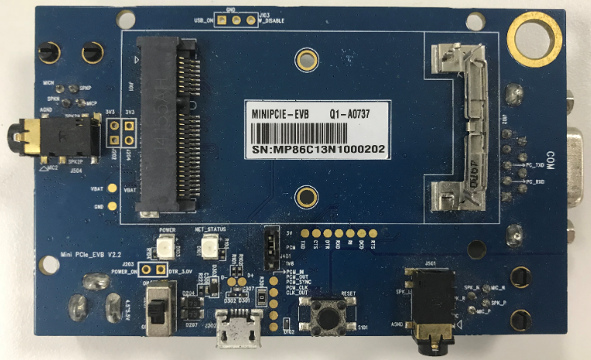
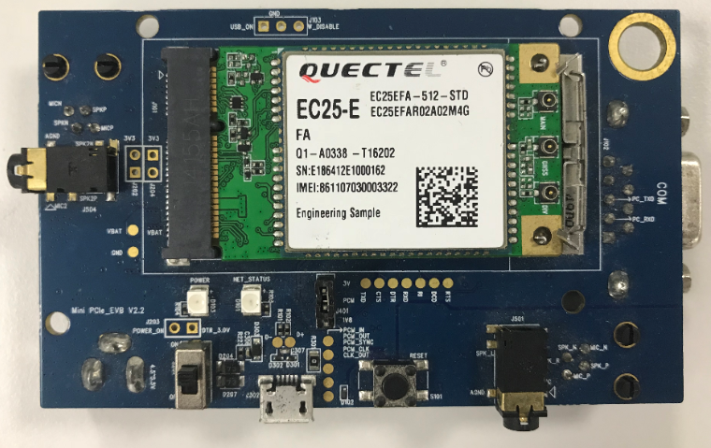
MINI PCIe EVB Kit
MINIPCIE EVB Kit
MINIPCIE EVB Kit with MINI PCIe Module

Slide 29
Ordering Code List
Model | Ordering Code
MINIPCIE EVB Kit | MINIPCIEEVB-KIT
EC25-E-MINIPCIE | EC25EFA-MINIPCIE

Slide 30
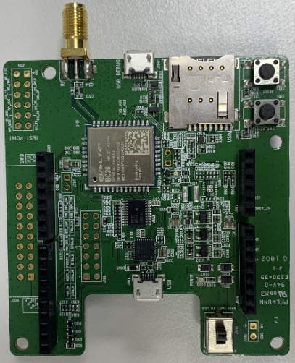
TE-B

Slide 31
Ordering Code List
Model | Ordering Code
BC26 TE-B | BC26-TE-B

Slide 32
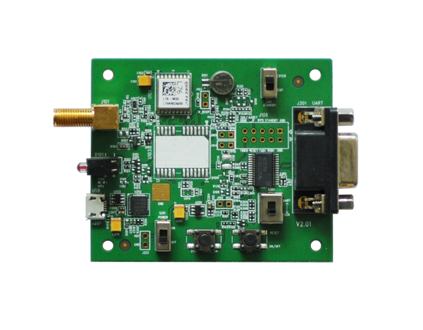
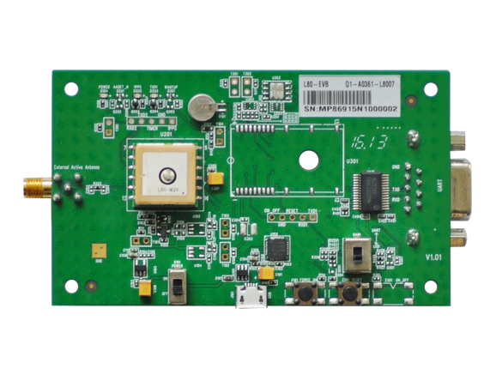
GNSS EVB
L76
L80

Slide 33
Ordering Code List
Model | Ordering Code
L76 EVB Kit | L76EVB-KIT
L80 EVB Kit | L80EVB-KIT

Slide 34
www.quectel.com
Thank you!
7th Floor, Hongye Building, No.1801 Hongmei Road, Xuhui District, Shanghai 200233, China
Tel: +86-21-5108 6236 Email: info@quectel.com
Website: www.quectel.com
https://www.linkedin.com/company/quectel-wireless-solutions
https://www.facebook.com/quectelwireless
https://twitter.com/Quectel_IoT

